Slide 1

Training and Communication
February 24, 2018

Slide 2
Advocacy
Obstacles to Advocacy
Political Climate
Economic Climate
Uncertainty of Future
Budget Constraints
SEQUESTRATION

Slide 3
MOAA Strategic Plan
Vision
Mission
Values
Service
Leadership
Professionalism

Slide 4
MOAA Goals 2018
TRICARE Fees
Military Pay
Comp. Reductions
Retirement/COLA
WW.Caregivers
Chapter 61
Survivors
Guard/Reserve
Military Families
VA/Health

Slide 5
NCCOC Goals
Membership/Recruiting
Organization/Communication
NC Legislation
National Legislation

Slide 6

Are you a member?

Slide 7
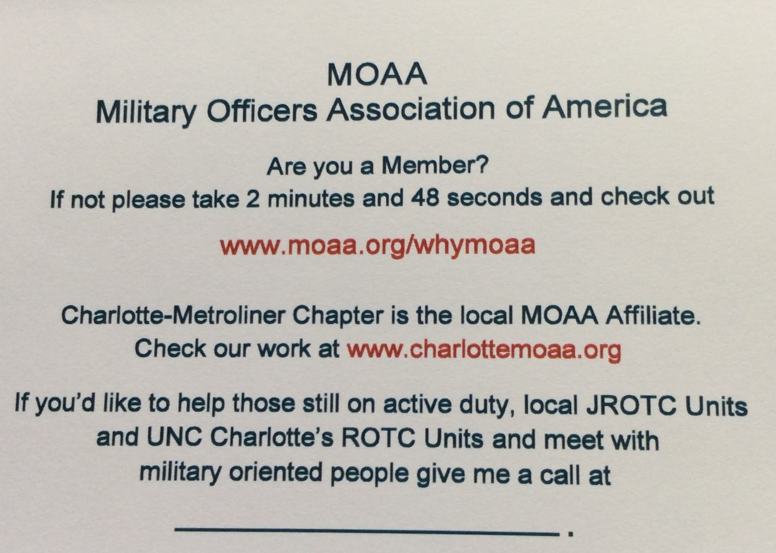

Slide 8
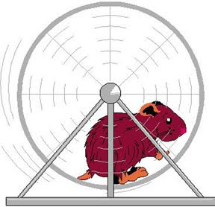
The Squeaky Wheel…

